Slide 1
We are the world?
DU Data Analytics Bootcamp : Project 1
By: Brandon Kaus, Chris Marchetti, Alex Monts
& Kiet Tung

Slide 2
How Does money change the world?
Our project attempted to gain insights into this question, and the questions listed below, by looking for links between GDP, U.S. Foreign Aid, World Bank Aid and the Human Development Index (HDI):
1. Does foreign aid affect a country’s standard of living?
2. Does foreign aid impact GDP?
3. What are the sources of US foreign aid ?
4. Does the type of aid impact HDI or GDP?

Slide 3
Definitions
Foreign Aid - “The international transfer of capital, goods, or services from a country or international organization for the benefit of the recipient country or its population. Aid can be economic, military, or emergency humanitarian.” (Britannica.com)
Human Development Index(HDI) - Is a composite index that measures people and their capabilities as a means to assess the development of a country. Life Expectancy Index, Education Index and Gross National Income Index are used to derive the HDI. (HDI.org)

Slide 4
Definitions
Gross Domestic Product (GDP) - “Total monetary or market value of all the finished goods and services produced within a country's borders in a specific time period. As a broad measure of overall domestic production, it functions as a comprehensive scorecard of the country’s economic health.” (Investopedia.com)
Gross National Income (GNI) - “The sum of a nation's gross domestic product and the net income it receives from overseas.” (Investopedia.com)

Slide 5
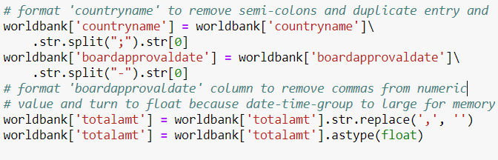

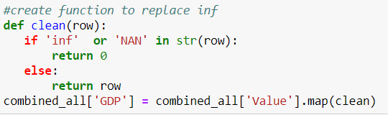
Data clean-up
Splits and Strips
Removing / Dropping Columns
Removing NANs and Inf

Slide 6
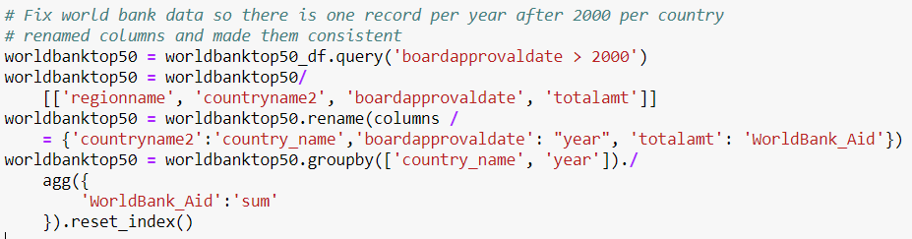
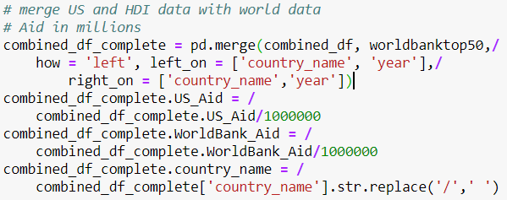
Merge Data Sets
Grouping Data & Identifying Keys
Normalizing Data

Slide 7
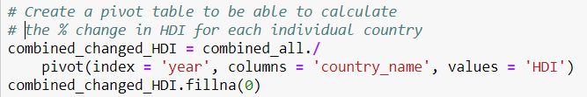
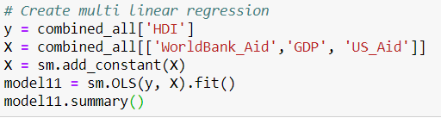
DATA ANalysis
Pivot Tables
Linear Regression

Slide 8
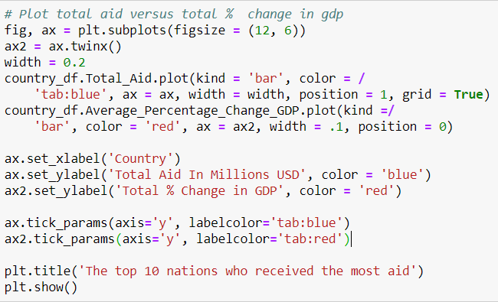
Data Visualization
Visualizations: Summary Data

Slide 9
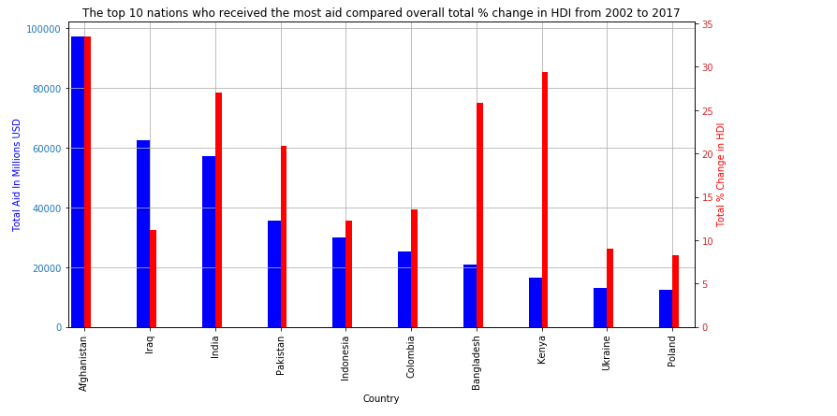
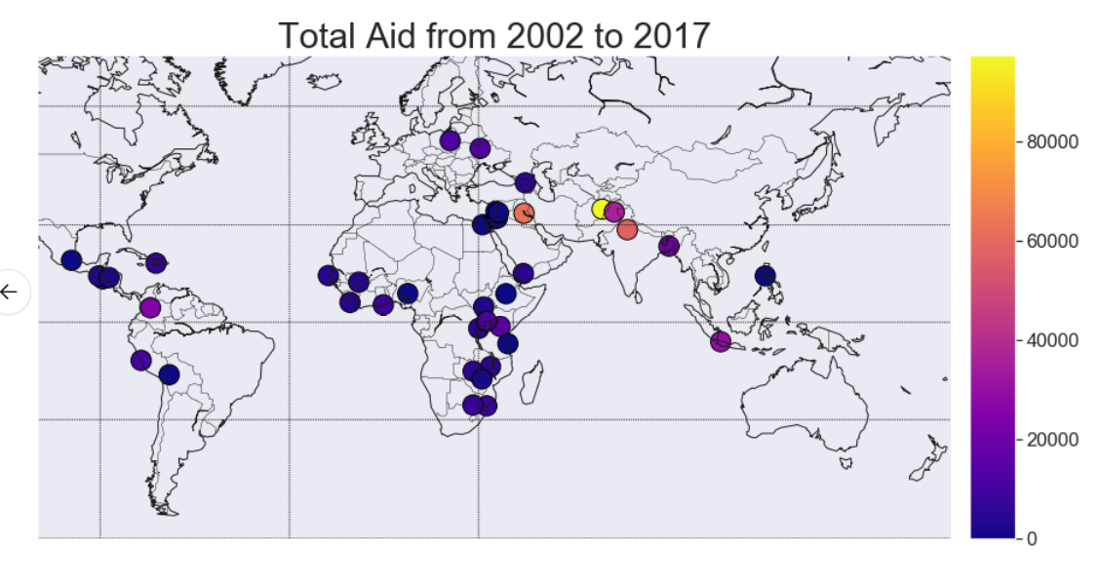
insights

Slide 10
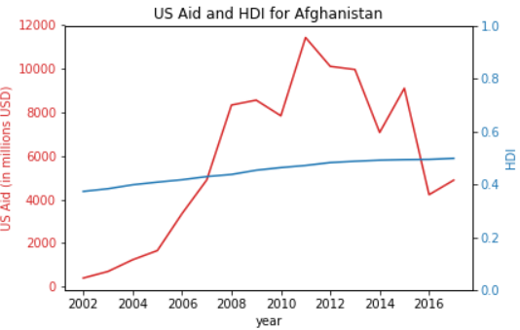
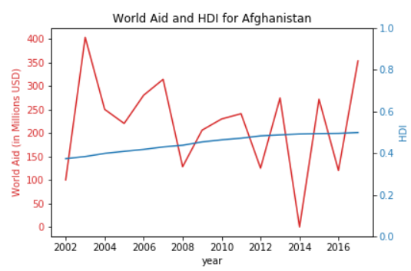
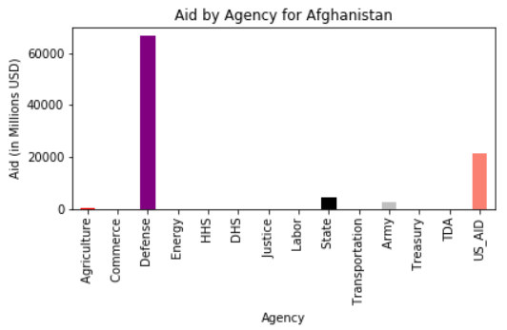
insights

Slide 11

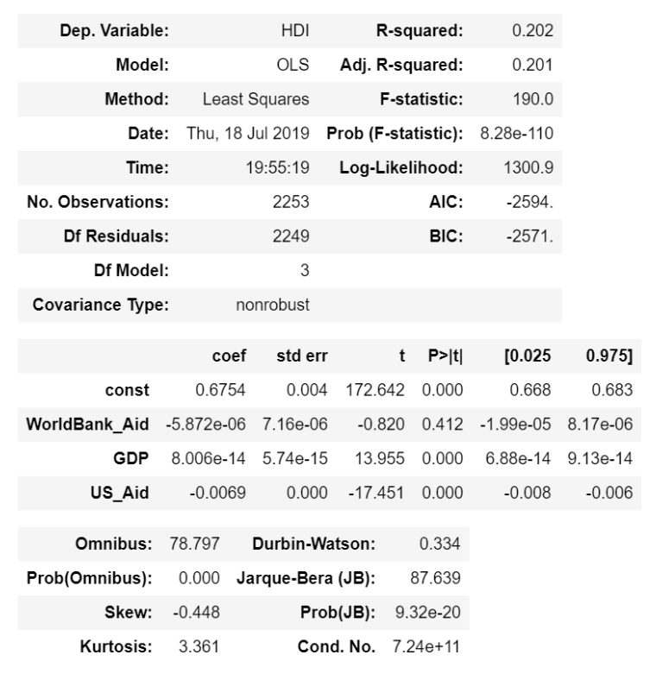
How Does Aid Affect Living Standards?
Conclusion #1
Does not appear that there is a strong correlation between Aid and HDI outcomes
Conclusion #2
Both GDP and USAID had a statistically significant impact on HDI outcomes.
Conclusion #3
Low R-squared. Different treatment of NANs and adding population may increase ability to identify connection between GDP, USAID and HDI

Slide 12
Thank YOU!

